Slide 1
Lynden School District
Medication Administration Training Manual for Non-Licensed School Personnel
Kathy Vanderveen, RN 318-6044; Karen Matheis, LPN 815-4056; Sharon Reese, LPN 296-4774

Slide 2
Course Objectives
Upon completion of this course, unlicensed school personnel will be able to:
Understand how medication administration may be safely delegated
Identify the responsibilities of the school nurse and unlicensed school personnel in medication administration
Understand local school board policies for medication administration
Recognize and apply the six (6) rights of medication administration
Identify proper storage of prescription and over-the-counter medication

Slide 3
Course Objectives
Understand appropriate and correct documentation of medication administration
Understand proper action and documentation necessary for refusal and omission of scheduled medications
Understand prevention of medication efforts and incident reporting
Recognize when it is appropriate to contact additional resources (i.e., nurses, physicians, poison control and emergency medical services)

Slide 4
Course Goals
This course is intended for non-licensed personnel
who have accepted the delegation to provide medication administration to students in a school setting. Staff members will participate in an in-service training session prior to the opening of school each year. Delegation is only valid for the current school year.

Slide 5
Course Goals
Upon successful completion of this course,
the non-licensed school employee will demonstrate competency, as determined by the delegating registered nurse (RN), in:
Administration of student medication
Verification of student instruction on self-administration of medications
Administration of emergency medications for students with allergic anaphylactic reactions

Slide 6
Course Description
This course is designed to include four modules:
Module I: Legal Issues, Policies and Procedures
Module II: Classification of Medications, Medication Preparation, Administration and Documentation
Module III: Emergency Medication Administration
Module IV: Local School Board Policies and Procedures

Slide 7
Medication Administration Open Book Exam and Demonstration of Skill Competency
A study guide has also been developed to assist with this training material. Personnel will be expected to score a 100% on the skill competency evaluation and 85% on an open book final exam which will include demonstration of:
1. Reviewing student medication history on Medication Administration Record/Medication log for documentation of allergies and other co-existing medical conditions
2. Using proper hygiene/universal precautions in medication preparation
3. Accurately identify student medication information by comparing medication label to the transcribed Medication Administration Record/Log

Slide 8
Medication Administration Open Book Exam and Demonstration of Skill Competency
4. Application of:
a. Eye drops/ointment
b. Ear drops
c. Topical ointments/creams
Administration of oral medications
Correct use of oral inhalers
Use of emergency medication (EpiPens®)
8. An understanding of school district policies and procedures

Slide 9
Module I
Legal Issues
Policies and Procedures

Slide 10
Introduction
There is much more to administering medications than just handing a student a pill and keeping the medicine bottle in a drawer. This curriculum was developed to give school personnel more information about:
Current Washington laws
School district policies and procedures regarding delegation of medication administration
Process of administering medication
Correct and appropriate documentation
When to seek additional assistance from resources such as a nurse, poison control or emergency medical services

Slide 11
Laws Related To Medication Administration
The number of students with complex health issues attending school is increasing. Some require prescribed medications at a scheduled time daily. Others may require over-the-counter medication episodically. Some students may have a chronic health condition that requires an emergency medication or treatment to reduce the threat of a potential life-threatening event.

Slide 12
Laws Related To Medication Administration
An understanding of state laws and school district policies and procedures is necessary to reduce the potential liability issues of medication administration in the school setting. School personnel who accept the delegation of medication administration, and comply with the training, delegation, and supervision provided by the school nurse, successfully complete this course, including demonstrated competency, are protected from liability under Washington state law.

Slide 13
Laws Related To Medication Administration
Only licensed physicians and surgeons, dentists, osteopathic physicians and surgeons, naturopathic physicians, podiatric physicians and surgeons, physician assistants, osteopathic physician assistants, and advanced registered nurse practitioners (ARNPs) are licensed to “prescribe” medication (RCW 18.71 and RCW 18.79).
Nurses are licensed to “administer” medications. 504 Policy 3416, allows only registered nurses, in the school setting, to delegate the task to administer medications to persons who have completed a course such as this, and have demonstrated competency (RCW 28A.210.260).
School personnel may be trained to administer the emergency medications- inhalers and EpiPens®. (RCW 28A.210.260, 18.79.240(1) (b), and 504 Policy 3416, Guidelines for Care of Students with Anaphylaxis)

Slide 14
Laws Related To Medication Administration
1. Advanced Registered Nurse Practitioner
It is within the scope of the ARNP to provide primary healthcare services to students in accordance with WAC 246-840-300, scope and standards of practice of ARNPs. The ARNP may also perform acts within the scope of registered nursing practice.
2. Registered Nurse Practice
It is within the scope of registered nursing practice (WAC 246-840-705) for a registered nurse, qualified by education, experience, and current clinical competence to provide school health services/acts including but not limited to the following:

Slide 15
Laws Related To Medication Administration
    Utilize substantial, specialized nursing knowledge, judgment and skill in providing primary healthcare to students including "... initial assessment, management of minor illness and/or referral to other health professionals, monitoring of chronic diseases, health supervision, counseling, promotion of healthy life-styles, disease prevention, and the coordination of services when specialized care is required." (National Association of School Nurses, Resolution--Primary Health Care, June 1981.)
    Serve as a health advocate of students, and a consultant to educational staff
    c. Serve in family resource and youth services centers

Slide 16
Laws Related To Medication Administration
    Provide health teaching with a focus on disease prevention, health promotion and health restoration
    Monitor the quality of the healthcare services provided for students
    f. Provide direct clinical services for students with special needs and/or teach and verify competency, supervise and delegate [as defined in RCW 18.79.040(1)(0) and RCW 18.79.260(2)] the performance of select acts to unlicensed school personnel in accordance with the administrative regulation governing delegation of nursing tasks to unlicensed persons

Slide 17
Laws Related To Medication Administration
    Participate in the development of policies and procedures to guide nursing practice in school settings (RCW 28A.210.260), and to address expanding school health services to students, families and communities
    h. Delegate select health services to a school employee in accordance with RCW 18.79.040(1) (0) and RCW 18.79.260(2).

Slide 18
Laws Related To Medication Administration
3. Licensed Practical Nurse Practice
LPNs are not licensed for independent nursing practice. The board recognizes the participation of the LPN in school nursing practice when the LPN is qualified by education, experience and current clinical competency and practices under the direction and supervision of a designated RN.
Both the RN and LPN must hold a current license from the Nursing Care Quality Assurance Commission (NCQAC) and their licenses must be renewed annually.

Slide 19
Laws Related To Medication Administration
The NCQAC has the legal authority to regulate nursing practice in order to safeguard the health and safety of citizens of Washington. Delegation is defined as “the transfer of responsibility for the performance of an activity from one individual to another, while maintaining the accountability for the outcome.”
School health services (i.e., the administration of medications) may be delegated to unlicensed school personnel according to related sections of RCW 28A.210.260 and RCW 28A.210.270, which describes who may delegate health service(s) (ARNP, RN), the training and documentation of the training. The delegation and training is only valid for the current school year.

Slide 20
Laws Related To Medication Administration
The delegating school nurse will also be responsible for ongoing training and competency evaluations of the non-licensed personnel to safeguard the health and welfare of the students in their care.
Supervision is defined as “the provision of guidance by a qualified nurse for the accomplishment of a nursing task with periodic observation and evaluation of the performance of the task.” The evaluation should include validation that the nursing task has been performed according to established standards of practice. Even when unlicensed school personnel perform the task, the nurse who delegates the task, will retain the responsibility for the outcome. Supervision of unlicensed school personnel does not require the delegating nurse to be present in the same building. The delegating school nurse should be available by phone for consultation.

Slide 21
Role of Unlicensed Personnel in Medication Administration
Unlicensed school personnel may be delegated selected health services according to RCW 28A.210.260.
Unlicensed school personnel should only accept delegation that he/she knows is within his/her skill set or knowledge and should always contact the supervising school nurse if unclear about administering a medication. Unlicensed personnel have the responsibility to follow school district policies and procedures.

Slide 22
Confidentiality and Privacy
Confidentiality is a very important legal concept. The Family Educational Rights and Privacy Act (FERPA) is the federal law that protects the privacy interests of students and their educational records. Health records maintained by school employees for pre-kindergarten through grade 12 students are protected by FERPA.
Information regarding student health information should be shared with school personnel only on a “need to know” basis. Certain student health information may be necessary to share with school personnel who may be assisting with medication administration. This information is confidential and should not be shared with other students or school employees
(RCW 70.02.030-050).

Slide 23
Other Legal Considerations in Medication Administration
All school districts should have written policies and procedures on medication administration. The purpose of these policies and procedures are to give guidance to the local school district employees and students. Each school district employee administering medications should be familiar with their district’s policies and procedures on medication administration.

Slide 24
Administration of Medication
1. Prescribed medication – whether medication requires a prescription or is over-the-counter (OTC):
Prescribed medication must be sent to the school in the original labeled container and the label shall include:
a. Name of the student
b. Expiration date of the medication
c. Name of the medication, dosage and strength of medication
d. Route of administration
e. Frequency of medication

Slide 25
Administration of Medication
f. Name and address of the pharmacy*
g. Name of the prescribing health care provider*
h. Date the prescription was dispensed*
*These would be included only on prescription medications from the pharmacy.
An authorization form completed by the parent/legal guardian and the student’s health care provider (HCP) must be kept in the medication notebook and is only valid for the current school year.

Slide 26
Administration of Medication
2. Student self-medication
Student self-medication is allowed in certain situations, with a written health care provider’s authorization, that allows a student to responsibly carry self-administered medication (e.g., EpiPen® or asthma inhaler). An authorization form must be completed by the parent/guardian and health care provider and on file in the school. This authorization must be renewed each school year and be approved by the school nurse. Documentation from the prescribing HCP shall include:

Slide 27
Administration of Medication
a. The student has demonstrated proper technique and is capable of administering the prescribed medication
b. The name and purpose of the medication
c. The prescribed dosage of the medication
d. The times at which or circumstances under which the medication may be given
e. The period of time for which the medication is prescribed
f. The side effects and further instructions if order is for more than fifteen days.

Slide 28
Administration of Medication
3. Medication safety
Except for “self-carry” medications, all medication should be brought to the school by a parent or guardian and picked up.
Prescribed medication should be counted and the number of pills received should be noted on the Medication Administration Record and signed by two adults.
Medication shall only be administered according to the health care provider’s instructions on the Medication Authorization form and this should match the information on the prescription label.

Slide 29
Administration of Medication
Discrepancies that exist between the information on the Parent/Guardian Authorization Form and the prescription label will require one of the following:
a. New authorization form completed by the parent/guardian and HCP
b. New prescription bottle or label issued by the pharmacy
Medications shall not be given beyond the date specified on the authorization form, or beyond the expiration date on the label.

Slide 30
Administration of Medication
4. Changes in medication
The authorization to administer medication is only valid for the current school year or until treatment changes. A new Authorization for Medication Administration form must be obtained whenever there is a change to the medication, dosage, time and/or frequency and a new prescription bottle (or medication label if applicable) from the pharmacy indicating the prescription change.
Nurses may only accept medication orders as prescribed by HCPs with prescriptive authority.

Slide 31
Storage and Disposal of Medications
Except for emergency medications, all medications should be kept in an appropriately labeled, secure, locked container or cabinet accessible only to the responsible authorized school personnel. Medications requiring refrigeration shall be kept in a separate refrigerator in a supervised area or locked container. Temperature of that refrigerator will be checked on a regular basis.

Slide 32
Storage and Disposal of Medications
It is recommended that no more than a month’s supply of medication be stored on school property.
When a medication is no longer needed, the school should notify the parent/guardian and request that it be picked up by the parent/guardian.

Slide 33
Storage and Disposal of Medications
For disposal of unused medication or expired medication:
For pills: Pour into wet coffee grounds. After pills have
dissolved, they may be thrown into garbage can.
For liquids: Pour into coffee grounds. This may be placed in plastic bag and then thrown into garbage can.
Disposal of medication must be documented on the student’s medication record to verify it was destroyed, sign, date and have a witness also sign and date.
Items such as inhaler canisters may be placed in a sharps container or disposed of according to the school district’s Bloodborne Pathogen OSHA plan.
5. Expired EpiPens® are used by school nurses for unlicensed staff training.

Slide 34
Field Trips and Medication Administration
If a student is attending a field trip away from school during his/her scheduled medication time, school personnel with current training on medication adminis-tration may be designated to administer the medication while on the field trip.
Notification and preparation for administering medications during a field trip should begin well in advance of the day of the field trip (at least two (2) weeks). The school should request the parent send a separate bottle to be sent on the field trips.

Slide 35
Refusal of School Personnel to Administer Medications
When school personnel are unable to grant the request from a parent/legal guardian/HCP to administer medication to a student, the delegating school nurse should be notified as soon as possible. Some of the circumstances may include:
1. Medication was sent to school out of the original container
2. Medication is prescribed twice daily and can be administered before school and after school hours
Medication is prescribed three times daily and can be given before school, after school and before bedtime
No written authorization is on file
Refusing medications is not considered a medication error and should be documented on the Medication Administration Record as “refused medication.”

Slide 36
Medication Errors
Preventing and Reporting Medication Errors
A medication error occurs when one of the “six rights of medication administration” has been violated. Examples are:
1. Administering the wrong medication
2. Administering the wrong dose of medication
3. Administering medication at the wrong time
4. Administering the medication in the wrong way (e.g., ear drops administered to eye)
Administering medication to wrong student
Failing to document that medication was given or inaccurate
documentation of medication given

Slide 37
Medication Errors
Medication errors may result in adverse reactions to the student. These reactions could range from a rash to a life-threatening situation. Therefore, always check the medication label when:
1. Removing the medication from storage
2. Removing the medication from its container
3. Returning the medication to storage

Slide 38
Medication Errors
Knowing the following before administering medications will help prevent medication errors:
1. Name of medication (the generic and real or “trade” name)
2. Purpose
3. Potential side effects
4. Special instructions (if appropriate)
5. Health care provider and emergency contact names and phone numbers

Slide 39
Medication Errors
When a medication administration error occurs, follow these guidelines:
1. Keep the student in the health room or office (where they can be observed)
2. If the student has already returned to class, have an adult accompany the student back to the health room or office, for observation
3. Observe the student’s status and document what you see
4. Identify the incorrect dose or type of medication taken by the student
5. Notify the principal and supervising school nurse immediately if medication was given by non-licensed personnel (the supervising nurse will contact the parents of the student and/or health care provider)

Slide 40
Medication Errors
6. If contacting the Poison Control Center for instructions:
a. Give the name and dose of the medication taken in error
b. Give the student’s age and approximate weight
c. Give the name and dose of any other medication the student receives
7. Follow instructions from the Poison Control Center. If unable to follow their instructions, explain the problem to the Poison Control Center to determine if the student should be transported for emergency care.

Slide 41
Medication Errors
8. Complete a Medication Administration Incident Report form. Carefully record all circumstances and actions taken, including instructions from the Poison Control Center or the student’s health care provider, and the student’s status. All reports are to be filed and kept according to district policy.
Errors made in recording medications on the Medication Administration Record should be marked “error,” initialed and dated. Whiteout may not be used nor documentation “blacked” out.

Slide 42
Module II
Classification of Medications
Medications Preparation
Administration & Documentation

Slide 43
Classification of Medications
Prescription Medications
Controlled/scheduled medications
“Controlled/scheduled medications” are medications that are potentially addictive and that are regulated under the Controlled/Scheduled Substance Act of 1970. Controlled/ scheduled medications cannot be obtained without a written prescription from a licensed practitioner (e.g., Ritalin® or Tylenol® with Codeine).

Slide 44
Prescription Medications
Non-controlled/scheduled medications
All prescription, non-controlled/scheduled medications (e.g.,Tegretol® or Dilantin®) require an order from a HCP. All non-controlled/scheduled medications are kept locked according to school district policies and procedures. School district policies will address student safety in relation to secure storage of medication.

Slide 45
Prescription Medications
C. Over-the-Counter (OTC) Medications
OTC medications are administered to students according to school district policy. OTC medications require a completed authorization form by the parent/legal guardian and the student’s HCP. Examples of these medications would be ibuprofen (Motrin®), acetaminophen (Tylenol®), cough medication (Robitussin®), antibiotic ointment (Neosporin® or Bactracin®), antacids (Tums® or Rolaids®), etc. Documentation of OTCs on the student’s Medication Administration Record is required.

Slide 46
Medication Resources
The chart “Common Medications” (Handouts section) lists commonly used medications. These medications may be controlled or non-controlled. The chart is not an all inclusive list. It is very important that a person administering medications compares the medication label with the medication record including the student’s name, time of administration, how the medication is to be given and the dosage for administration. All OTC medications must be given in accordance with school district policies.

Slide 47
Understanding Effects of Medications/Adverse
Drug Effects
It is very important to be familiar with any medication that is being administered. An adverse effect is an unwanted, unexpected and/or dangerous reaction to a drug. Pharmacies are required to provide
a “medication” education sheet with each drug dispensed.
A current drug handbook is also available online at the:
National Institute of Health’s website Medline Plus: http://nlm.nih.gov/medlineplus/druginformation.html

Slide 48
Understanding Effects of Medications/Adverse
Drug Effects
Observing the student after a medication has been administered is crucial in identifying any adverse reactions to that medication. If a student vomits after taking a medication, report to the supervising school nurse. Severe adverse reactions should be treated as emergencies.
An allergic reaction is an immune response to a foreign substance resulting in inflammation and/or organ dysfunction. In the case of medications, the drug itself may be the substance that causes the effect.
Anaphylaxis is the most dangerous type of an allergic reaction. Anaphylaxis is a life-threatening event, where the blood pressure drops, respiratory distress occurs (i.e., shortness of breath), and the student may become unresponsive. Emergency procedures should be implemented if anaphylaxis is suspected.

Slide 49
Various Forms of Medication Administration
A. Oral (by mouth)
Oral medications include solid forms such as tablets or capsules and liquid forms such as syrups/elixirs and suspensions. Oral medication should not be crushed without an HCP’s order.
Tablets (pills) come in many forms: regular, chewable, sublingual and scored. Regular tablets are simply taken with liquid. Chewable tablets should be chewed before they are swallowed. Tablets that are not clearly designated as chewable should be swallowed whole. Scored tablets are designed so that they can be cut up into smaller doses with a special cutting tool. Tablets are delivered in either enteric coated or uncoated form. Certain medications can cause irritation to the stomach. These tablets are “coated” so that they cannot dissolve in the stomach, protecting the stomach from irritation. The “coating” actually dissolves in the small intestine instead of the stomach. These tablets should not be split or crushed.

Slide 50
Various Forms of Medication Administration
A. Oral (by mouth) (cont.)
Oral disintegrating tablets dissolve in the mouth (do not chew). Sublingual medications are placed under the tongue to be dissolved and absorbed. Buccal medications are placed inside the cheek and along the gum line to be dissolved and absorbed.
Capsules are coated so they dissolve over a period of time in the stomach or the intestines - but not in the mouth. Most often, the prescription calls for capsules to be swallowed whole, just like tablets. Gel coated capsules are not to be broken.
Capsules may be coated with substances that permit delayed release in the small intestine in small amounts over a prolonged period of time.

Slide 51
Various Forms of Medication Administration
A. Oral (by mouth) (cont.)
Syrups and elixirs are clear liquids. Suspensions are liquids that are not clear. Suspensions contain medication that doesn’t dissolve completely in the liquid and usually need to be refrigerated. Because suspensions can separate, they always need to be shaken at least 15 seconds before being measured and given to the student.
All oral medications should be given with water or other liquid that allows for easy swallowing.

Slide 52
Various Forms of Medication Administration
Topical
Topical medications include eye drops or ointments, ear drops or ointments, and creams and ointments that are applied to the skin. NOTE: Gloves should be worn when administering any of the following medications. Hands should be washed before and after use of gloves. Be sure to wash your hands after removing gloves.
Ointments (salves) are a semisolid preparation, usually containing a medical substance, used for external application on the skin.
Creams are a fluid mixture of a thick consistency, usually applied to the skin or body surface.
Drops are a liquid form of medication given through a dropper when a very small dose of medication is required. Drops are usually prescribed for the eyes (ophthalmic) or ears (otic).

Slide 53
Various Forms of Medication Administration
C. Inhalers and Nebulizers
Inhaled medications may be delivered in a fine mist by spray bottle/inhaler, an oral inhaler or nebulizer machine. Most inhalers are hand-held portable devices that deliver medication at a metered (pre-measured) dose.
A nasal spray/inhaler is medication delivered as a spray directly into the external nares (nostrils). At this time in Washington state schools, nasal medications are not delegable tasks and may not be administered by non-licensed school personnel.
Oral inhalers deliver medication directly to the lungs through the mouth. The nebulizer produces a fine spray mist by rapidly passing air through a liquid. Common inhaler problems include:

Slide 54
Various Forms of Medication Administration
Inhalers and Nebulizers (cont.)
Not taking the medication as prescribed
Incorrect activation which may occur by not following the recommended sequencing of inhaling and squeezing the canister
Forgetting to shake the canister - if the canister is not shaken multiple times, the correct amount of medication may not be delivered-also, prime as indicated per manufacturer instructions
Not waiting long enough between puffs
Failure to clean the valve - if debris is present, this will cause delivery failure of the correct amount of medication
Failure to observe whether the inhaler is actually releasing a spray;
if not, call the delegating school nurse

Slide 55
Until recently, all MDIs contained a chemical harmful to the earth’s ozone (CFC). The government is requiring that all MDIs be transitioned to HFA (hydrofluoroalkane) inhalers which are more environmentally friendly. The new HFA propelled inhalers are different than what most students may be accustomed, and education may be required. Some differences include:
Prescriptions and student instructions should be appropriate to each product
The propelled spray (plume) with HFA propelled inhalers are softer than CFC propellants and students need to be reassured that they will be receiving the correct dose of active ingredient
HFA MDIs have different cleaning requirements
HFA MDIs have different priming requirements
ALWAYS CONSULT THE STUDENT’S ASTHMA ACTION PLAN/PRESCRIPTION FOR INSTRUCTIONS ON HOW TO ADMINISTER THE INHALER

Slide 56
  Various Forms of Medication Administration
  Emergency Medications
EpiPen® is an emergency injectable medication (epinephrine) prescribed for treating severe allergic reactions causing life-threatening respiratory distress, or a condition referred to as anaphylaxis.

Slide 57
Handling Medication
A. Hand Washing Before administering any medication to a student, always wash your hands.
B. How to Avoid Touching the Medication
Pour pills, tablets, or capsules into the bottle cap first,
then pour them into the disposable medicine cup.

Slide 58
Cutting or Crushing Tablets
Cutting, crushing or sprinkling of the medication are examples of changing the form of an oral medication.
If the form of an oral medication must be changed, the prescribing health care provider will indicate this in the written prescription and on the pharmacy label.
Scored tablets that must be cut in half to obtain a smaller dose should be cut by the parent/guardian or the student’s dispensing pharmacist.

Slide 59
Measuring Liquid Medication
When pouring liquid medications, always place bottle cap upside down on a solid surface to avoid contaminating the inside of the bottle cap. Always use a plastic marked medicine cup, oral syringe or dropper. Place the cup on a solid, level surface and look at the medicine cup at eye level to ensure the correct amount has been poured.
Hold the bottle so the label is in the palm of your hand to prevent spillage and causing the label to be illegible. Some liquid medications are suspensions and require shaking before being administered.

Slide 60
Ensuring Accurate Administration of Medication
“Six rights of medication administration” must be followed.
Only set up and administer one individual's medication at a time. Never document administration of the medication before the student receives it.
Prescription Label Example
Pharmacy #04849
4838 Polar Level Rd
Louisville, KY 40213
DEA: BR860780
RPHL JWI (initials of pharmacist)
Date filled: 8/27/02
04849
Right Student
Jones, Haley
Right Dose, Right Time, Right Route
Take 1 tablet every 8 hours by mouth
Precare Caplet 25 mg
QTY: 30 Expires 8/27/03
Right Drug
MFG: Ther-rx
Dr. James Lind (prescribing physician)

Slide 61
Procedure for Administering Medications
All medication administration procedures must include these basic steps regardless of the type of medication to be administered:
Student reports to office or call student to the office (or staff go to the student)
Verify identity of student (using two methods of identification)
Identify yourself and what you will be doing
Assemble necessary equipment
Wash your hands before and after administering medications

Slide 62
Medication Errors
Any error must be documented on the school district’s “medication error” or incident form and reported as soon as possible to the school nurse, school principal and parents.
Report accidental errors such as:
Forgetting to give a dose of medication
Giving medication to the wrong student
Giving the wrong medication or the wrong dose
Giving medications at the wrong time
Giving medication by the wrong route

Slide 63
Refusal of Medications
Refusing medications is not considered a medication error, and the refusal should be documented on the Medication Administration Record as a “refused” medication. The parent/guardian will be notified should he/she refuse the scheduled medication. Be sure to notify your school nurse as soon as possible.

Slide 64
Medication Documentation
Record-keeping is very important when medication is given at school. A medication “log” (medication administration record) must be kept for each student.
Each medication given must be recorded on a separate form.
The log contains the student’s name, the prescribed medication and dosage, the route the medication is to be given, the time the medication is scheduled to be given and any student allergies.
Compare the information on the medication label with the information on the medication request form.

Slide 65
Refusal of Medications
Contact the school nurse immediately and do not give the medication if the medication label is missing or the label cannot be read.
The back of the medication request form may be used to also make notes of additional comments of any unusual circumstance related to the student receiving the medication. This medication record becomes a permanent part of the student’s file. The actual time must be recorded on the medication record. When a medication is missed due to an absence or a field trip, or if the student refuses to take the medication, is a legal and permanent document. It is to be saved for 8 years. Use only ink and never use “whiteout.” If a mistake is made draw a single line through the time, write “error” and initial/date beside the time.

Slide 66
Handouts available:
Common Medication Abbreviations
Glossary of Medical Terms
Steps for Proper Hand Washing
Six Rights of Medication Administration
Brand and Generic Names of Common Medications
Medication Administration Incident Record Form (Sample)
Student Self-Medication Authorization
Core Competencies:
Oral Medication Administration
Liquid Medication Administration
Eye Drops or Ointment
Ear Drops
Topical Ointment or Creams
Metered Dose Inhalers
How to Administer an EpiPen®

Slide 67
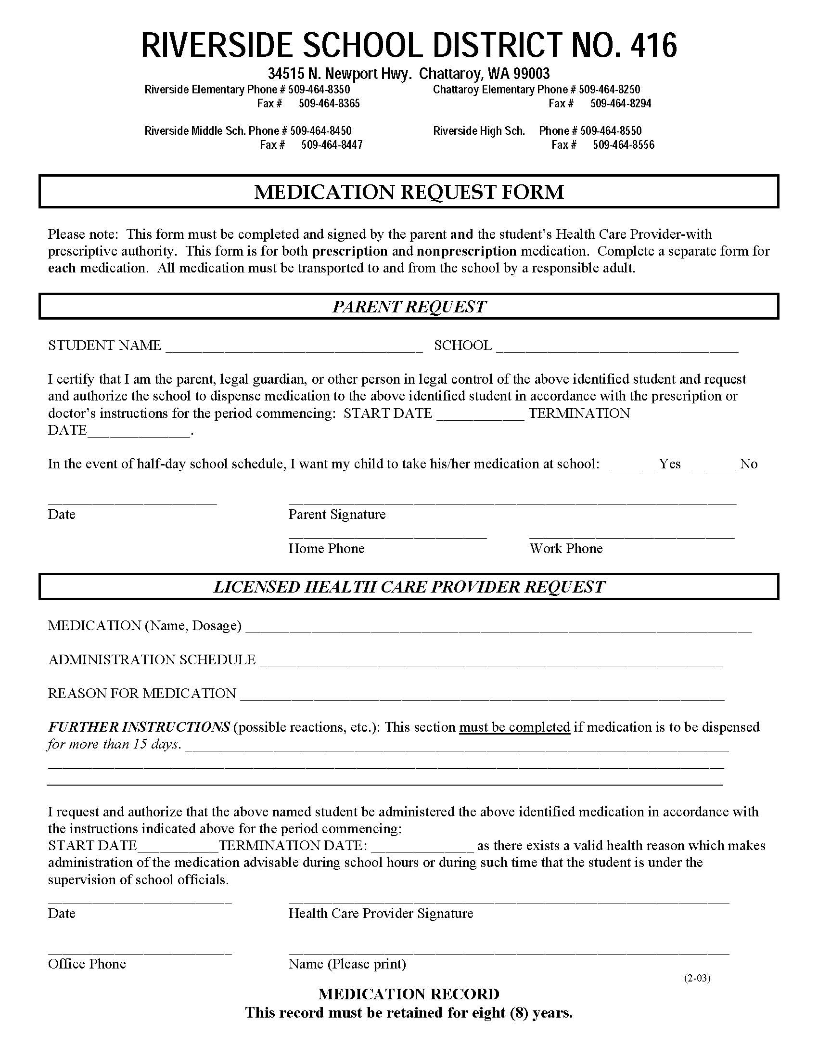
SAMPLE

Slide 68
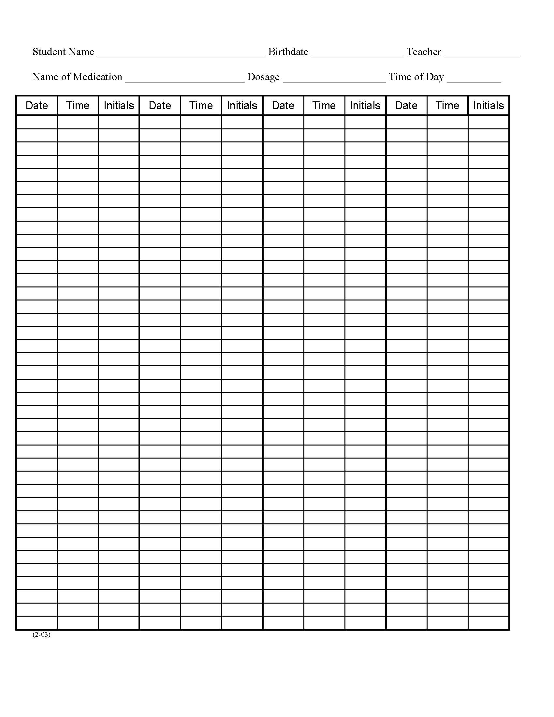
SAMPLE

Slide 69
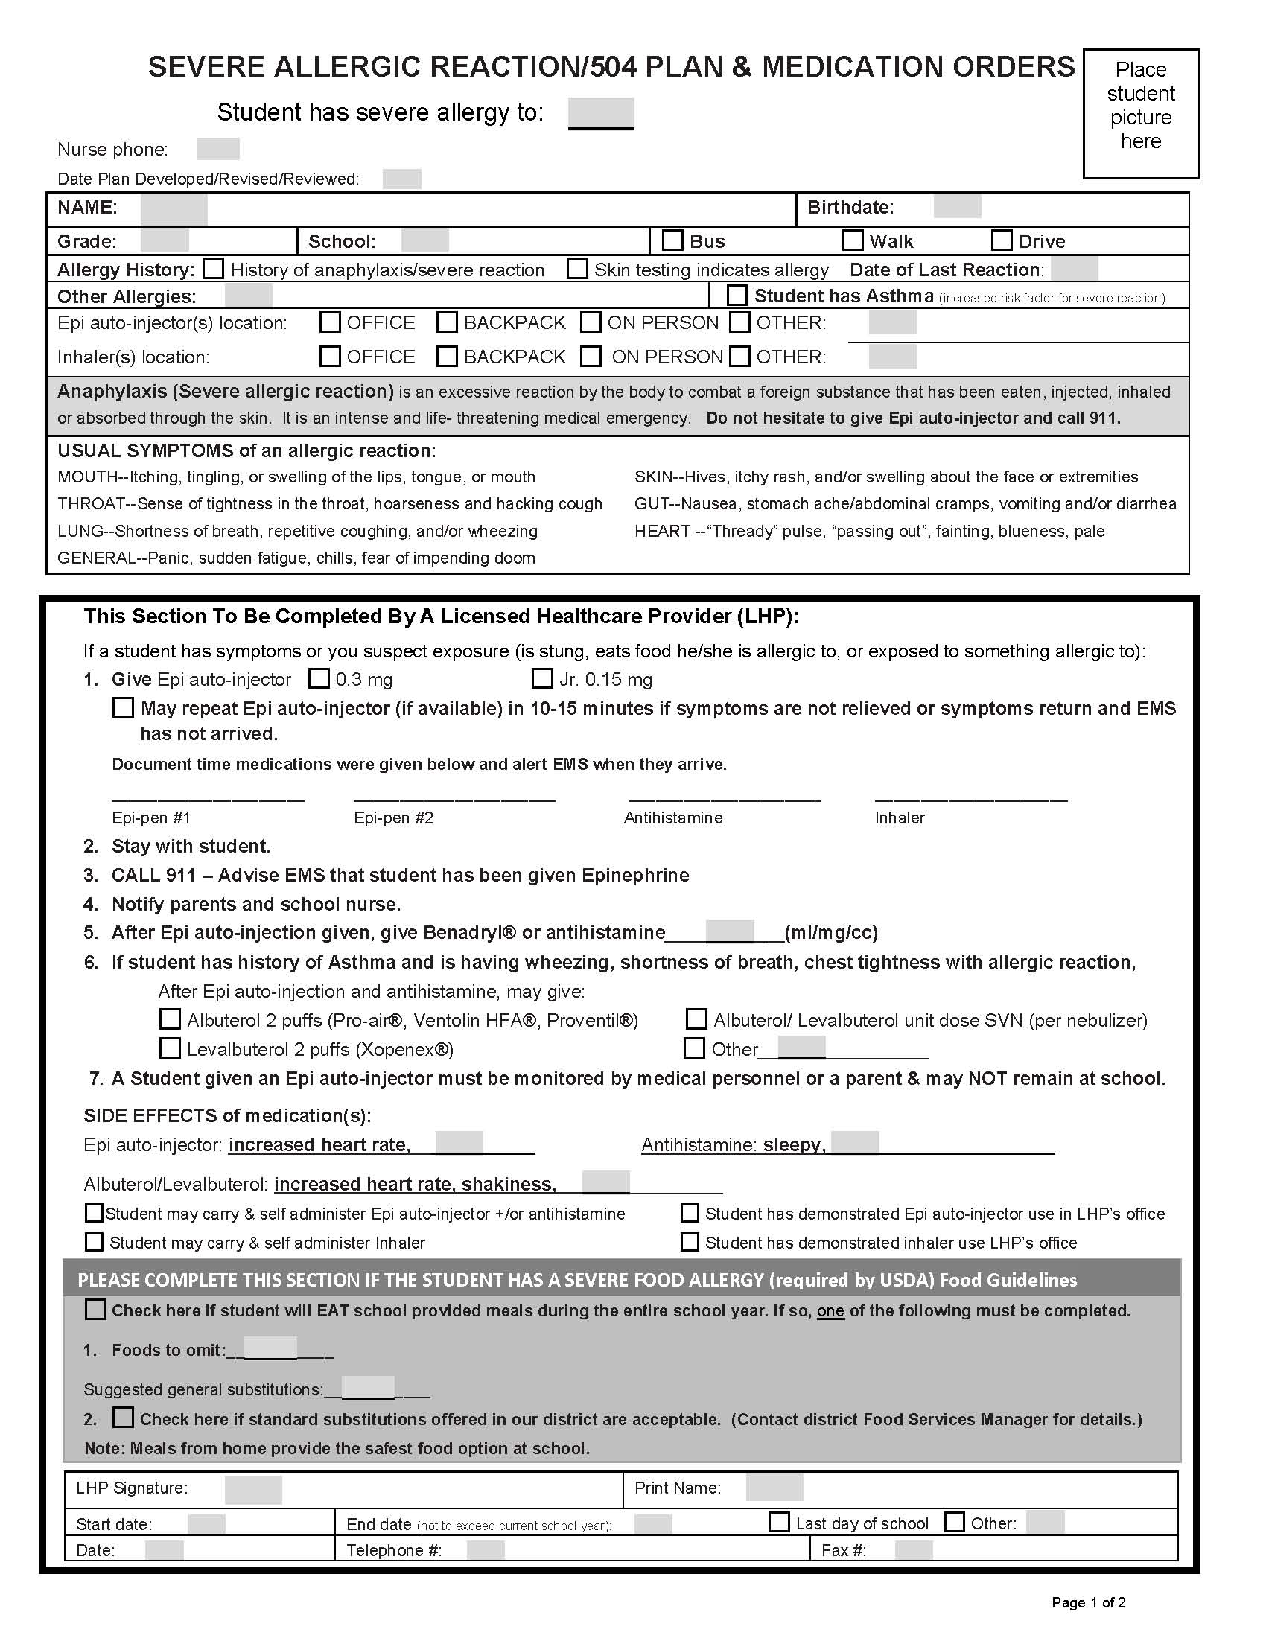
SAMPLE

Slide 70
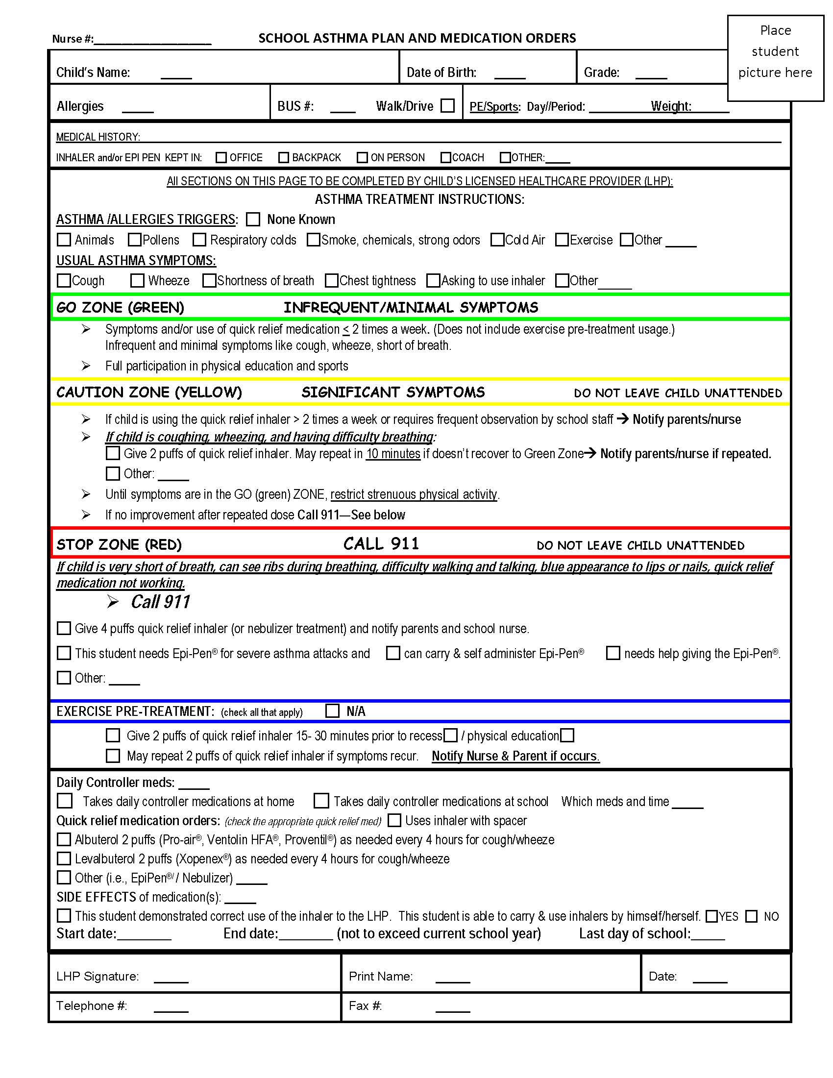
SAMPLE

Slide 71
Module III
Emergency Medication Administration

Slide 72
Epinephrine for Anaphylaxis
Anaphylaxis is a life-threatening allergic reaction that can be fatal within minutes. Anaphylaxis can be a reaction to food, stinging insects, medications, latex or exercise.
Symptoms of anaphylaxis include:
Itching and/or hives, particularly in the mouth or throat
Swelling of the throat, lips, tongue and/or eye area
Difficulty breathing, swallowing or speaking
Increased heart rate and/or sense of impending doom
Abdominal cramps, nausea, vomiting, diarrhea
Weakness, collapse, paleness, lightheadedness or loss of consciousness

Slide 73
Epinephrine for Anaphylaxis
An allergic response may rapidly progress to anaphylaxis. Students with severe allergies have an Individualized Healthcare/Emergency Care/504 plan.
Once anaphylaxis has begun, the treatment is an immediate injection of epinephrine (EpiPen®) which may be effective for only 10-15 minutes. It is not necessary to remove the student’s clothing before administering the EpiPen®. The student should then be transported for further emergency medical attention at the nearest hospital emergency room.
Some students may carry and self-administer an EpiPen®.
The manufacturer recommends the EpiPen® be stored at room temperature in a dark area. The expiration date of the EpiPen® kit should be checked monthly.

Slide 74
Module IV
Local School District
Policies and Procedures

Slide 75
Medication Administration
Local school district policies for medication administration should include:
Consent forms to be signed by parent/guardian giving authorization to the school district to administer medication
HCP forms to be signed regarding medication administration instructions
The above policies would also address prescription medication, OTC medication and self-administered medication.

Slide 76
Handouts

